Slide 1
Modelling Credit ratings of international banks
Authors:
MSc student Ella Khromova
Doctor of Economics, Professor Karminsky Alexander M.

Slide 2
Actuality of the paper and the aim of the research
Aim of the paper
To create a reliable model of credit ratings for international banks based on the publicly available information
Actuality of the paper
valuable for banks themselves for internal control of financial performance under increasing importance of IRB approach
valuable for regulators who control the financial stability of the banking system as a whole.
valuable for counteragents in order to choose the optimal investment strategy

Slide 3
Goals of the paper
Goals of the paper
Make a review and comparison of academic literature on the following topic
Compose a table of representative variables that have potential influence on ratings
Construct a relevant sample from the database
Make a model for forecasting banks credit rating
Check in sample and out of sample fit
Make conclusions on the hypothesis of the paper

Slide 4
Analysis of Literature
What kinds of methodologies are used for modelling credit ratings?
Statistical models:
Linear probability model, LPM
Multinomial ordered logit/probit model (Hajek, Olej, 2010; Karminsky et al., 2006)
Discriminant analysis (Altman, 1968)
Artificial intelligence models: (Bennell et al., 2006; Cao et al., 2006; Huang et al., 2004; Kim, Kee, 2005; Kumar, Bhattacharya, 2006)
Neural networks
Support vector machines
Case-based reasoning

Slide 5
Factors of potential
influence
Factor | Actual ratio | Reference
1.Franchise value
Sustainability | Sustainable Growth Rate = ROE x (1 - dividend-payout ratio) | Moody’s methodology
Market share | Revenue market share (%) = 100 * Sales Revenue ($) / Total Market Sales | Karminskiy et al., 2007; Wu, Hsu, 2012
Market structure | Log of the ratio of the number of banks to the population in a country | Schaeck et al., 2006;
Market discipline | Interbank ratio | Schaeck et al., 2006; Allen et al., 2011
Geographical diversification | Number of foreign countries where a bank operates | BvD; Author’s suggestion
Earnings stability | Percentage from one standard deviation of the variability around the trend line of total earnings | Öğüt et al., 2012
Earnings Diversification | 1.Other earning assets/total earning asset 2.Loans to banks/ tot earn asset 3.Derivatives, other securities/tot earn asset 4.Remaining earning asset/ tot earn asset | Karminskiy et al., 2007; Wu, Hsu, 2012; Caporale et al., 2012

Slide 6
Factors of potential
influence
Factor | Actual ratio | Reference
2.Corporate governance
Ownership& organizational complexity | Number of interdependent and interconnected stakeholders | Grunert et al., 2005; Distinguin et al., 2013;
Key-man risk | The effect losing one important member of the team causes. | Moody’s methodology
3.Regulatory environment | Index of regulator’s independence | BvD; Moody’s methodology
4.Operational environment | 1.Corruption index 2.Sovereign rating | Teker et al., 2013; Karminskiy et al., 2007
Macroeconomic indicators | GDP real growth rate (%) Public debt / GDP (%) Unemployment (% of labour force) Current account balance International reserves | Teker et al., 2013; Karminskiy et al., 2007, 2008

Slide 7
Factors of potential
influence
Factor | Actual ratio | Reference
5.Financial Fundamental
Profitability | 1.ROA, ROE 2.Net interest margin 3.Net interest revenues/ avg assets 4.Income net of distrib / avg equity 5.(EBIT+Loan Loss provision)/RWA 6.Dividend payout ratio | Moody's Investors Service, 2011; Wu, Hsu, 2012.
Efficiency | 1.Cost to income ratio = Operational expenses/ operating income | Karminskiy et al., 2010; Öğüt et al., 2012; Caporale et al., 2012.
Liquidity | 1.Current ratio 2.(market funds-liquid assets)/total assets 3.Deposits/ equity | Moody's Investors Service, 2011; Karminskiy et al., 2010; Wu, Hsu, 2012.
Capital adequacy | 1.Tier 1 2.Equity/total assets 3.Equity/Debt (leverage) | Karminskiy et al., 2007; Wu, Hsu, 2012.
Asset quality | 1.Impaired loans/gross loans 2.Loan loss reserves/ gross loans 3.Impaired loans/(equity+ loan loss reserves) 4.Unreserved impaired loan/equity | Distinguin et al., 2013; Karminskiy et al., 2007.

Slide 8
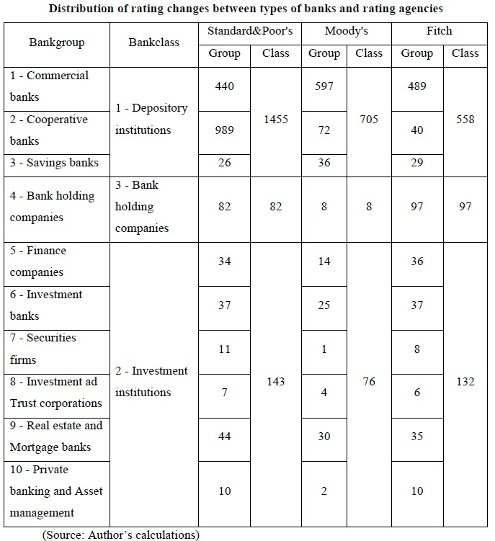
Data
Source: BankScope
Time period: 1996-2011
Type: quarterly data
Initially: 30331 international banks
After first data filtration:
29212 banks left

Slide 9
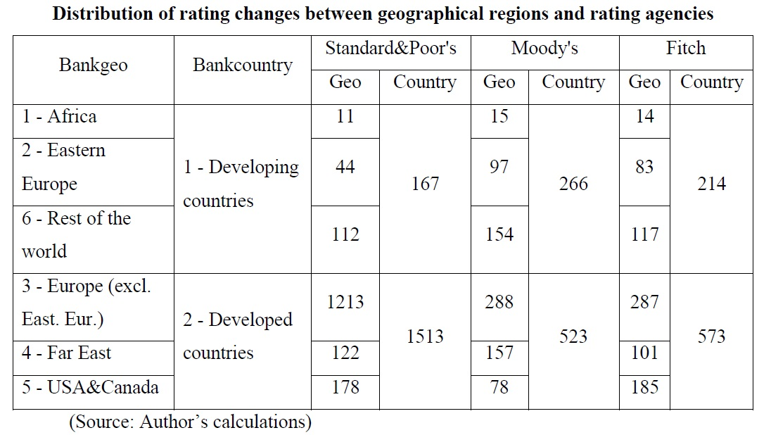
Data on bank’s ratings
However, credit rating was assigned only to 3256 banks
Data concerning banks ratings contains only info about the date of last rating change and its value

Slide 10
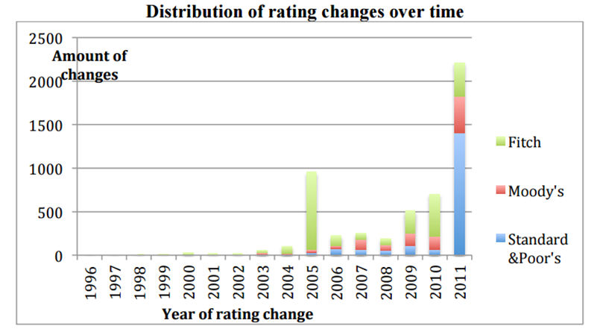
Data on bank’s ratings
Samples of the rating changes are:
2609 banks for Fitch
1051 banks for Moody’s
1977 banks for S&P

Slide 11
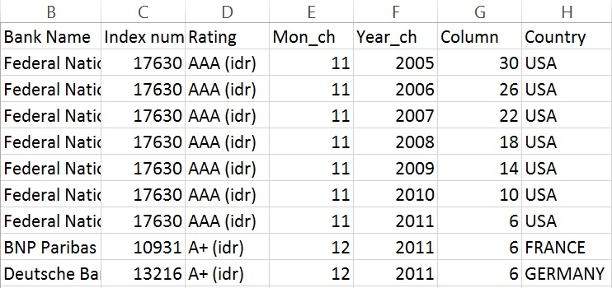
Construction of a representative sample
Fitch:
N=27
=>
N=1501

Slide 12
Formulation of the dependent variable
Risk characteristic | Moody’s | Fitch | S&P | Class numeration | Grade numeration
Prime | Aaa | ААА | ААА | 1 | 1
High grade | Аа1 | AA+ | AA+ | 2 | 2
 | Aa2 | AA | AA | 2 | 3
 | Aa3 | AA- | AA- | 2 | 4
Upper medium grade | A1 | A+ | A+ | 3 | 5
 | A2 | A | A | 3 | 6
 | A3 | A- | A- | 3 | 7
Lower medium grade | Baa1 | BBB+ | BBB+ | 4 | 8
 | Baa2 | BBB | BBB | 4 | 9
 | Baa3 | BBB- | BBB- | 4 | 10
Non-investment speculative grade | Ba1 | BB+ | BB+ | 5 | 11
 | Ba2 | BB | BB | 5 | 12
 | Ba3 | BB- | BB- | 5 | 13
Highly speculative | B1 | B+ | B+ | 6 | 14
 | B2 | B | B | 6 | 15
 | B3 | B- | B- | 6 | 16
Substantial risks | Caa1 | CCC | CCC+ | 7 | 17
Extremely speculative | Caa2 | CC | CCC | 7 | 18
In default with little prospect for recovery | Caa3 | C | CCC- | 7 | 19
 | Ca | - | - | 8 | 20
In default | C | D | D | 10 | 21

Slide 13
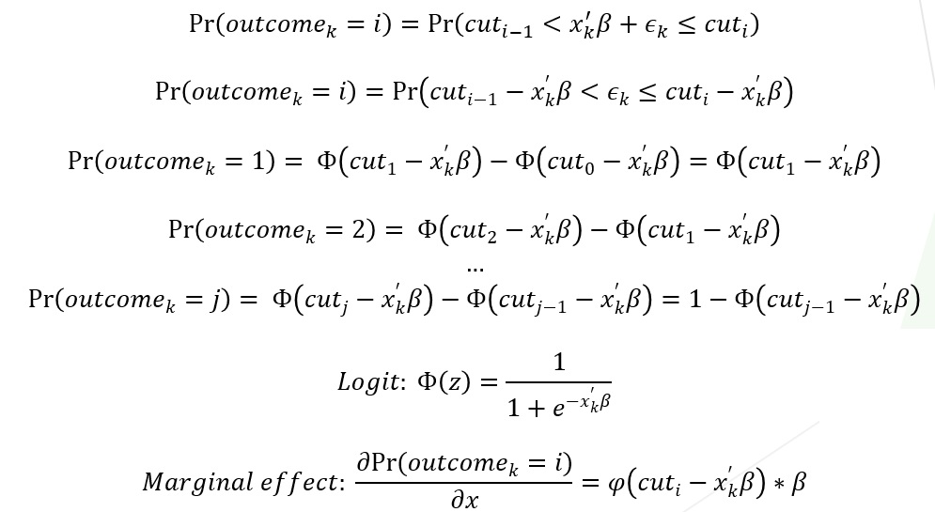
Empirical methodology
Multinomial ordered probit/logit model
Estimating by maximum
likelihood method
$x_{k}^{′}−$ vector of independent variables;
$β−$ vector of estimated regression coefficients;
${{cut}_{1},{cut}_{2}…cut}_{j−1}−$ estimated cutpoints;
${cut}_{0}=−∞ {cut}_{j}=+∞$ ;
$ε_{k}−$ logistically or standard normally distributed disturbance term.

Slide 14
 | Moody’s Grade forecast | Moody’s Class forecast | S&P Grade forecast | S&P Class forecast | Fitch Grade forecast | FitchClass forecast | Total sample Class forecast
Loan loss res. / gross loans | 0,159*** (0,014) | 0,171*** (0,017) | 0,148*** (0,026) | 0,146*** (0,247) | 0,169**** (0,017) | 0,154*** (0,016) | 0,162*** (0,011)
Equity/ Debt | -0,011*** (0,003) | -0,01*** (0,003) | -0,006 (0,008) | -0,0004 (0,008) | -0,003 (0,006) | -0,006 (0,006) | -0,011*** (0,003)
Cost to income ratio | 0,009*** (0,003) | 0,012*** (0,003) | 0,009*** (0,003) | 0,009*** (0,003) | 0,007*** (0,001) | 0,007*** (0,002) | 0,007*** (0,001)
Log of total assets | -0,909*** (0,047) | -0,861*** (0,052) | -0,398*** (0,028) | -0,333*** (0,03) | -0,477*** (0,019) | -0,482*** (0,019) | -0,42*** (0,013)
Other earn. asst/ total earn. asst | -0,261 (0,233) | -0,182 (0,252) | -0,748** (0,321) | -0,908*** (0,333) | -0,135 (0,207) | -0,22 (0,204) | -0,41*** (0,144)
Interbank ratio | -0,0004** (0,0002) | -0,00007 (0,0002) | -0,0003 (0,0002) | -0,0001 (0,0002) | -0,001*** (0,0001) | -0,001*** (0,0002) | -0,0006*** (0,0001)
Dividend payout ratio | -0,0025*** (0,0007) | -0,003*** (0,0007) | -0,002*** (0,0007) | -0,002*** (0,0006) | -0,001** (0,0003) | -0,0009** (0,0003) | -0,001*** (0,0003)
Current ratio | -0,004*** (0,001) | -0,005*** (0,001) | -0,004*** (0,001) | -0,003*** (0,001) | -0,004*** (0,001) | -0,002 (0,001) | -0,003*** (0,0007)
Moody’s | - | - | - | - | - | - | -0,237*** (0,046)
S&P | - | - | - | - | - | - | 0,203*** (0,045)
Number of observations | 1109 | 1109 | 836 | 836 | 1501 | 1501 | 3443
Pseudo- R2 | 14,92% | 22,79% | 14,88% | 20,7% | 16,9% | 25,19% | 25,3%
AIC | 4779,704 | 2647,724 | 3265,498 | 1732,345 | 6137,76 | 3410,339 | 8040,946
BIC | 4909,996 | 2722,892 | 3388,443 | 1808,003 | 6265,294 | 3495,361 | 8157,684
Base Model

Slide 15
Financial coefficients
in the Model with macro and dummy variables
 | Moody’s Grade forecast | Moody’s Class forecast | S&P Grade forecast | S&P Class forecast | Fitch Grade forecast | FitchClass forecast | Total sample Class forecast
Loan loss res. / gross loans | 0,128*** (0,017) | 0,136*** (0,019) | 0,128*** (0,023) | 0,122*** (0,025) | 0,129*** (0,017) | 0,111*** (0,016) | 0,128*** (0,011)
Equity/ Debt | -0,012*** (0,008) | -0,014*** (0,004) | -0,015* (0,009) | -0,012 (0,009) | -0,006 (0,006) | -0,012* (0,006) | -0,014*** (0,003)
Cost to income ratio | 0,008*** (0,002) | 0,012*** (0,002) | 0,011*** (0,003) | 0,011*** (0,003) | 0,005*** (0,001) | 0,006*** (0,002) | 0,008*** (0,001)
Log of total assets | -0,962*** (0,052) | -0,911*** (0,057) | -0,411*** (0,03) | -0,341*** (0,03) | -0,517*** (0,021) | -0,524*** (0,021) | -0,445*** (0,015)
Other earn. asst/ total earn. asst | -0,706*** (0,266) | -0,631** (0,289) | -0,575** (0,278) | -0,719**(-*) (0,321) | -0,319 (0,215) | -0,377* (0,217) | -0,477*** (0,153)
Interbank ratio | -0,0005*** (0,0002) | -0,0005*** (0,0002) | -0,0003* (0,0001) | -0,00008 (0,0002) | -0,0004*** (0,0001) | -0,0005*** (0,0001) | -0,0003*** (0,0001)
Dividend payout ratio | -0,0016*** (0,0007) | -0,0015**(-*) (0,0007) | -0,002*** (0,0007) | -0,002*** (0,0007) | -0,0005*(-*) (0,0002) | -0,0004(-**) (0,0004) | -0,0008**(-*) (0,0003)
Current ratio | -0,002*(-**) (0,001) | -0,004**(-*) (0,002) | -0,006*** (0,001) | -0,005*** (0,001) | -0,0014(-***) (0,0013) | 0,0009 (0,0013) | -0,002**(-*) (0,0008)
Moody’s | - | - | - | - | - | - | -0,302*** (0,047)
S&P | - | - | - | - | - | - | 0,291*** (0,047)

Slide 16
Model with macroeconomic and dummy variables
 | Moody’s Grade forecast | Moody’s Class forecast | S&P Grade forecast | S&P Class forecast | Fitch Grade forecast | Fitch Class forecast | Total sample Class forecast
Developing | -0,775*** (0,119) | -0,655*** (0,137) | -0,155* (0,072) | -0,12* (0,041) | -0,285*** (0,069) | -0,244*** (0,083) | -0,551*** (0,049)
Inflation | 0,12*** (0,012) | 0,126*** (0,012) | 0,129*** (0,016) | 0,141*** (0,016) | 0,068*** (0,006) | 0,093*** (0,007) | 0,108*** (0,006)
Trade balance | -0,026*** (0,003) | -0,025*** (0,003) | -0,023*** (0,004) | -0,022*** (0,004) | -0,017*** (0,002) | -0,011*** (0,002) | -0,019*** (0,002)
GDP per head | -0,00003*** (0,000003) | -0,00003*** (0,000003) | -0,00002*** (0,000003) | -0,00002*** (0,000003) | -0,00003*** (0,000002) | -0,00003*** (0,000002) | -0,00003*** (0,000001)
Before crisis (1996-2007) | -0,471*** (0,079) | -0,521*** (0,09) | -0,449*** (0,088) | -0,611*** (0,04) | -0,548*** (0,067) | -0,661*** (0,075) | -0,551*** (0,049)
Year 2008 | -0,551*** (0,118) | -0,578*** (0,132) | -0,712*** (0,134) | -0,793*** (0,151) | -0,389*** (0,097) | -0,536*** (0,115) | -0,537*** (0,073)
Year 2009 | 0,231** (0,095) | 0,191** (0,085) | 0,161* (0,088) | 0,089 (0,098) | 0,042*** (0,052) | 0,332*** (0,092) | 0,213*** (0,071)
Year 2011 | 0,196** (0,081) | 0,16* (0,087) | 0,087 (0,096) | 0,064 (0,103) | 0,026*** (0,074) | 0,29*** (0,08) | 0,178*** (0,05)
Number of observations | 1094 | 1094 | 832 | 832 | 1498 | 1498 | 3421
Pseudo- R2 | 22,65% | 34,02% | 20,55% | 30,49% | 22,7% | 34,9% | 35,1%
AIC | 4316,914 | 2247,154 | 3055,793 | 1533,042 | 5729,552 | 2978,392 | 6975,02
BIC | 4476,837 | 2352,104 | 3206,955 | 1636,967 | 5888,909 | 3095,253 | 7122,324

Slide 17
Hypothesis
1. Usage of macro variables in the model of banks rating will improve its predictive power. (Bellotti et al., 2011; Caporale et al., 2012; Gropp et al., 2006; Karminsky et al., 2007; Teker et al., 2013)
+
2. Regional affiliation of banking institution has an influence on its rating. (Caporale et al., 2012; Karminsky et al., 2007)
+
3. Ratings are not changed when economy starts to operate on a different business cycle stage. (Altman, Rijken, 2004; Amato, Furfine, 2004; Peresetsky, Karminsky, 2007)
-
4. There are differences in the methodological approaches among different rating agencies. (Afonso, 2002; Karminsky et al., 2007; Vasiluk et al., 2011)
+

Slide 18
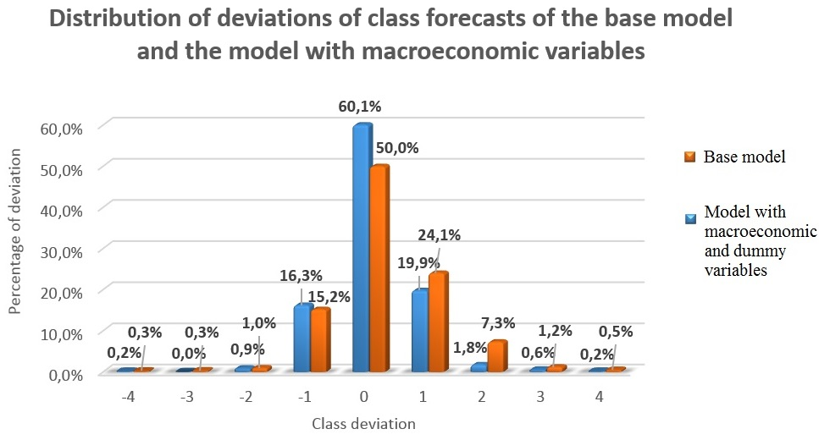
In-sample fit of
the model. Effect of macroeconomic variables
 | ∆=0 | |∆|<1
Base,% | 50,0 | 89,3
Macro, % | 60,1 | 96,3

Slide 19
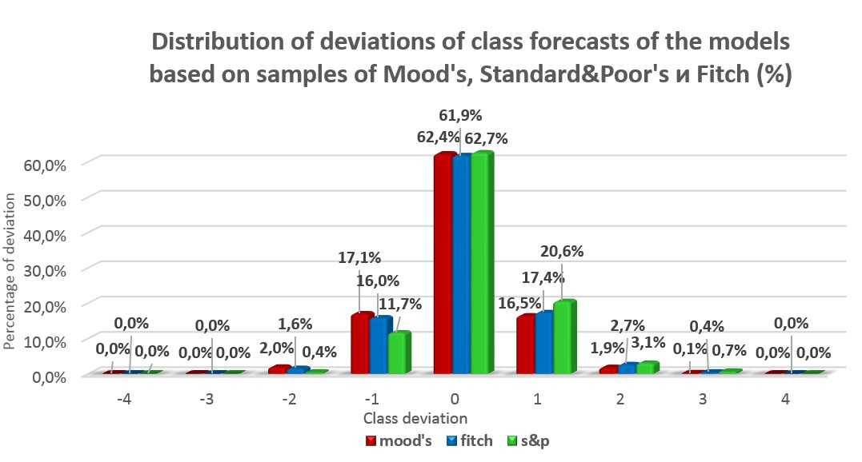
In-sample fit of
the model. Comparison class forecast of different agencies
Fitch tends to be the most conservative
Moody’s tends to be the most liberal
(Afonso, 2002; Karminsky et al., 2007; Vasiluk et al., 2011)
 | ∆=0 | |∆|<1
Fitch | 61,9% | 95,3%
Mood’s | 62,4% | 96,0%
S&P | 62,7% | 95,0%

Slide 20
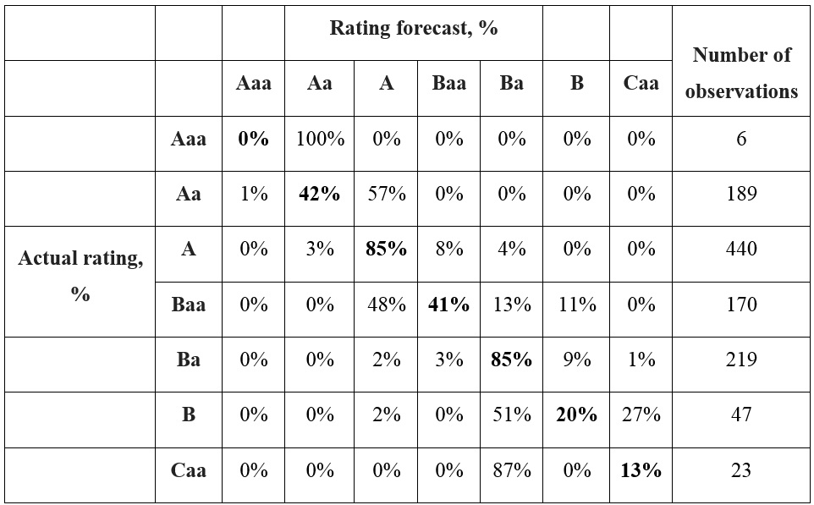
In-sample fit of
the model. Detailed analysis
of deviations
Classification of deviations of class forecasts of the model based on samples of Mood's ratings

Slide 21
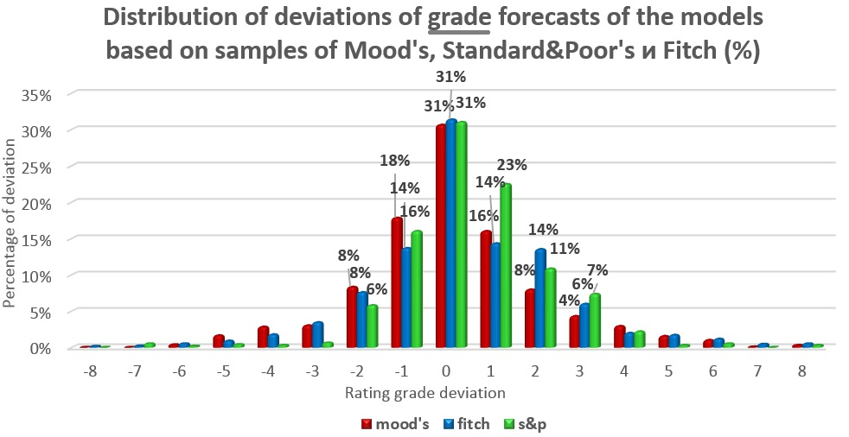
In-sample fit of
the model. Comparison grade forecast of different agencies
 | ∆=0 | |∆|<1
Moody’s | 30,7% | 64,7%
S&p | 31,4% | 70,3%
Fitch | 31,4% | 60,0%

Slide 22
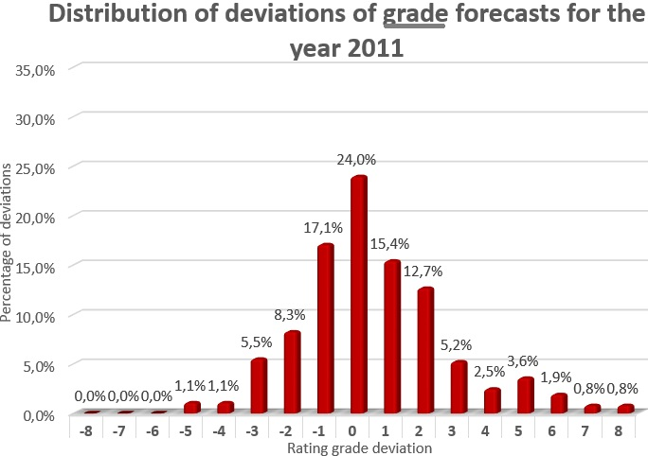
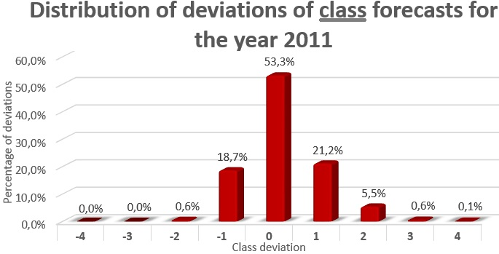
Out of sample fit of
the model.
Comparison grade
and class forecast
Use 1996 – 2010 for model construction
Forecast using estimated parameters probabilities for 2011
 | ∆=0 | |∆|<1
Grade | 24,0% | 56,5%
Class | 53,3% | 93,2%

Slide 23
Results
The list of significant and insignificant financial variables was obtained
Inclusion of macro variables has improved explanatory power of the model
Hypothesis of regional influence on banks ratings was not rejected
Rating agencies do change their grade when economy operates on the different business cycle stage
A conclusion of conservative nature of Standard&Poor’s ratings and overvalued Moody’s grades compared to the rating agency Fitch was made
The obtained model was classified as practically useful as predicting of rating grade gave 31% of precise results and up to 70% forecasts with an error within one rating grade, while predicting of rating class resulted in 62% and 95% respectively.

Slide 24
Uniqueness of the paper and Further research
Uniqueness of the paper
The model is based on a new comprehensive data base
New methods of increasing number of observations were provided
A set of unique indicators that influence credit ratings were obtained
Further research
Adding more qualitative indicators of institutional variables
Separate modelling of upgrades and downgrades of rating changes (Distinguin et al., 2013)
Use other statistical or artificial intelligence methodologies

Slide 25
Thank you for your attention!

Slide 26
Appendix 1: Correlation matrix
Explanatory variables with correlations higher than 35% were omitted

Slide 27
Appendix 2: Insignificant variables
Variable name | Problems | Conclusion
Sustainable Growth Rate = ROE x (1 - dividend-payout ratio) | Enough observations + Significant + Correct coefficient sign - | Dividend payout ratio included for controlling sustainability and profitability
1. Log of the ratio of the number of banks to the population in a country 2. Revenue market share (%) = 100 * Sales Revenue ($) / Total Market Sales | Enough observations - Significant - Correct coefficient sign + | Log of Total assets included for controlling market structure
Number of foreign countries where a bank operates | Enough observations - Significant + Correct coefficient sign + | Variable is not included
1. Sovereign rating 2. GDP real growth rate | Enough observations + Significant + Correct coefficient sign - | Real GDP per head included
1. Public debt / GDP (%) 2.Unemployment (% of labour force) | Enough observations + Significant - Correct coefficient sign + | Trade balance and Inflation variables are used for controlling macroeconomic variables
Volatility of total earnings | Enough observations + Significant - Correct coefficient sign - | Variable is not included
Dummy on the type of a bank (depositary institutions, investing institutions, hedge funds) | Enough observations + Significant -/+ Correct coefficient sign -/+ | Conclusion on insignificance of the variable is made

Slide 28
Appendix 3: Detailed deviations of class forecasts for S&P
S&P |  |  | Rating forecast, % |  |  |  |  | N
 |  | AA | A | BBB | BB | B | CCC
 | AA | 39% | 58% | 3% | 0% | 0% | 0% | 78
 | A | 4% | 92% | 4% | 0% | 0% | 0% | 447
Actual rating, % | BBB | 0% | 46% | 52% | 1% | 0% | 0% | 203
 | BB | 0% | 9% | 44% | 36% | 11% | 0% | 55
 | B | 0% | 3% | 9% | 14% | 66% | 0% | 44
 | CCC | 0% | 0% | 60% | 20% | 20% | 0% | 5

Slide 29
Appendix 4: Detailed deviations of class forecasts for Fitch
Fitch |  |  | Rating forecast, % |  |  |  |  |  | N
 |  | AA | A | BBB | BB | B | CCC | CC
 | AA | 62% | 37% | 1% | 0% | 0% | 0% | 0% | 325
 | A | 7% | 83% | 10% | 0% | 0% | 0% | 0% | 568
Actual rating, % | BBB | 1% | 10% | 60% | 25% | 4% | 0% | 0% | 323
 | BB | 0% | 8% | 42% | 40% | 10% | 0% | 0% | 120
 | B | 0% | 1% | 7% | 10% | 75% | 7% | 0% | 152
 | CCC | 0% | 0% | 23% | 37% | 40% | 0% | 0% | 7
 | CC | 0% | 0% | 0% | 50% | 50% | 0% | 0% | 2

