Slide 1
Does the information content of payout initiations and omissions influence firm risks?
Henk von Eije, Abhinav Goyal, and Cal Muckley
University of Groningen
University of Liverpool
University College Dublin

Slide 2
Preliminary remarks
We are very happy that the paper is accepted for publication in the Journal of Econometrics (special issue on the analysis of financial data) doi:10.1016/j.jeconom.2014.05.012
Still comments are very welcome, as we are in the process of extending this paper
We also hope that it provides a new look to matching in finance
If you are interested, I might –at the end- tell something about the process that led to acceptance

Slide 3
Motivation of the paper
Dividends and risk are two focal variables in finance, but the impact of payouts on risk is hardly studied
Miller and Modigliani (1961) proved the irrelevance of payouts for value in perfect markets, but not for risk
Consequently, the later literature discusses value effects of payouts in imperfect markets and much less risk effects
Because of the scant attention, we try to estimate the risk effects of payouts as precisely (and comprehensively) as possible

Slide 4
Relevance
Brav, Graham, Harvey and Michaely (2005) find that 37.5% of the managers agree with the idea that paying dividends makes the stock less risky (24.5% for repurchasing). Are these minorities correct?
Risk effects may result in value effects (Grullon, Michaely and Swaminathan, 2002)
The few authors who study risk effects focus on systematic risks, but idiosyncratic risk and total risk may also have value effects. Are they so small that they may be neglected?

Slide 5
Value effects after initiations and omissions
Positive value effects of announcements of dividend initiations (Healy and Palepu, 1988) and also after announcements of repurchase initiations (Ikenberry, Lakonishok, and Vermaelen, 1995)
Negative value effects are found after omissions of dividends (Healy and Palepu, 1988).
The omission effects are in absolute terms larger than the initiation effects

Slide 6
Value effects after dividend initiations …
… may arise from signaling larger expected cash flows (Bhattacharya, 1979), but the traditional signaling theory does not say anything on risks
… may also arise from reduced agency costs (Easterbrook, 1984), but the agency theory does not say anything on risks either
… may arise from signaling increased firm maturity (Grullon, Michaely, and Swaminathan, 2002) and investors conclude that the firm’s systematic risks have become smaller (and this results in value increases)

Slide 7
Idiosyncratic risk, maturity and value effects
Besides the systematic risk, idiosyncratic risk may also have value effects
High idiosyncratic risk is indicative of low firm maturity (young firms have growth options, which are risky)
Idiosyncratic risk may be priced (Levy, 1978; Merton, 1987; Fu, 2009) and this implies that if it declines after payout initiations, firm value may increase

Slide 8
Our sets of hypotheses
Pay out initiations influence the firm’s risks negatively and omissions will do so positively
Omissions will have a relatively larger absolute impact on firm risks than initiations
Dividends will have a larger impact on firm risks than repurchases (which are less sticky)

Slide 9
Economic novelty of our approach
Effects across initiations and omissions
Effects across pay out channels
Effects on idiosyncratic, aggregate systematic, and total risks
Focus on extreme pay out events: initiations and omissions
Really within the realm of semi-strong efficient markets

Slide 10
Econometric novelty of our approach
GMS (2002) and GM (2004) use matching on risk factors and differences in differences
We do not use risk factors, but a comprehensive set of observable variables that explain initiation and omission propensities
We then search for counterfactual firms that are similar to treated firms (which initiate -or omit- a payout) and compare the risk changes of the treated to the risk changes of the counterfactual firms (also DiD)

Slide 11
Within semi-strong efficient markets …
A payout initiation (or omission) may easily be anticipated, and therefore there may not be any news in such changes
So we tried to gauge what investors might know (we used 10 variables to capture their possible knowledge of payout initiations and 11 for knowledge of omissions)
Then we applied logit analysis to the initiations (omissions)
Using the resulting coefficients gave us the propensity scores for the likelihood to initiate (or omit) for all firms us

Slide 12
Matching on propensity scores
So we could find firms that were very comparable with respect to the propensity scores
So we applied various matching techniques to the propensity scores (nearest neighbor, local linear regression)
After matching we could compare the risk levels between treated (initiators and omitting) firms and counterfactuals after the treatment.
This is in fact a procedure where you control for time varying effects of changes in the covariates

Slide 13
Why also difference in differences?
Still we preferred to compare the risk changes of both treated and counterfactuals for two reasons:
We do not match on the risk measures, but we match on the propensity score to treat
Therefore the initial risk measures between treated and counterfactuals may differ and this may bias the estimated effects with pure PSM only (i.e. after PSM there may still be time invariant biases). DiD copes with that.
We, however, now have to assume that -during the measurement of the changes- the treated and matched counterfactual firms do not change systematically different

Slide 14
Further methodological innovations
We measure effects of actual payouts, because repurchase announcements are not all strong commitments
Measure changes in risk between t-2 and t+1
Omit confounding payout types from t-2 till t+1 to measure the pure effects of dividend and repurchase initiations and omissions

Slide 15
Summarizing our estimator
∆y is the change in risk
i is the payout (P) event
j is counterfactual (C=matched) firm
g is the weight of the counterfactual firm, based on the propensity scores (p_{i} and p_{j}) and e.g. local linear regression (PSMATCH2)

Slide 16
Population and measurements
Using up to 77,021 fiscal year observations of US firms (NYSE/NASDAQ) between 1972-2012
We exclude financials and utilities and require at least 48 weekly non-zero non-missing returns per fiscal year
We calculate (corrected for degrees of freedom):
the (weekly) standard deviation of the returns in excess of the risk free rate (total risk)
the standard deviation of the Fama and French (1993) residual (idiosyncratic) risk
and the square root of the difference between squared total and squared idiosyncratic risk (systematic risk)

Slide 17
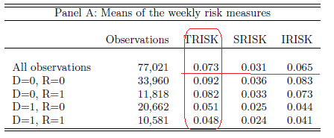
Risk Characteristics (Appendix 1)

Slide 18
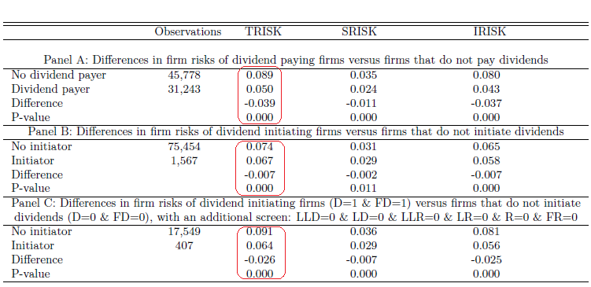
Table 1 part 1

Slide 19
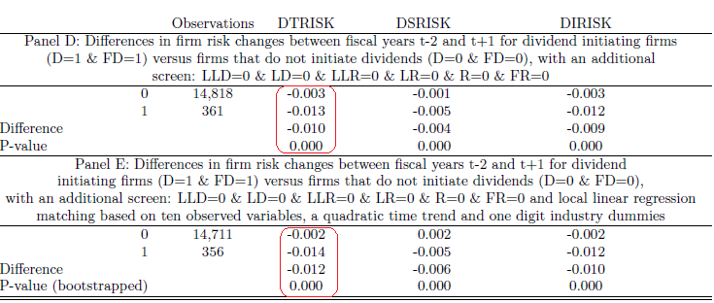
Table 1 part 2

Slide 20
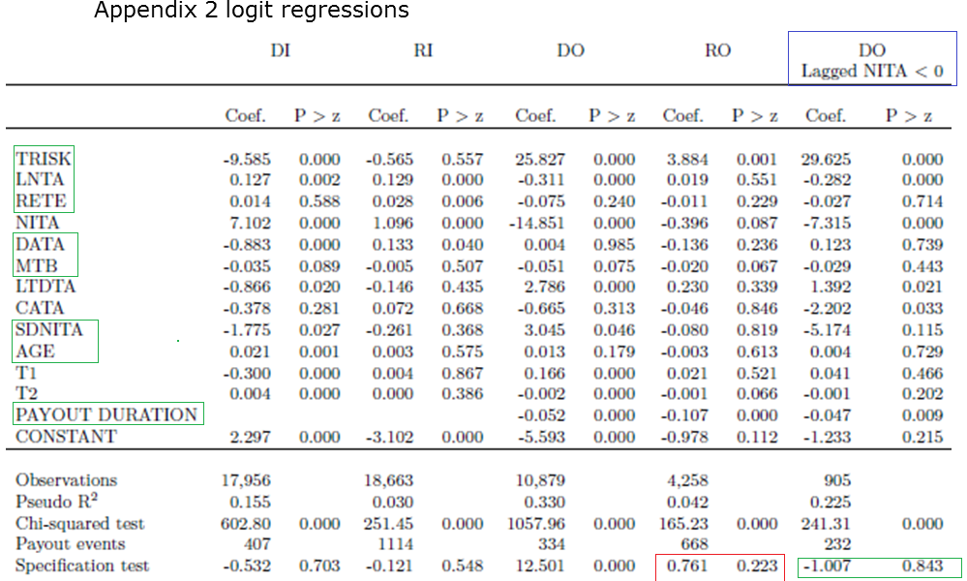
Appendix 2 logit regressions

Slide 21
Table 2 Panel A

Slide 22
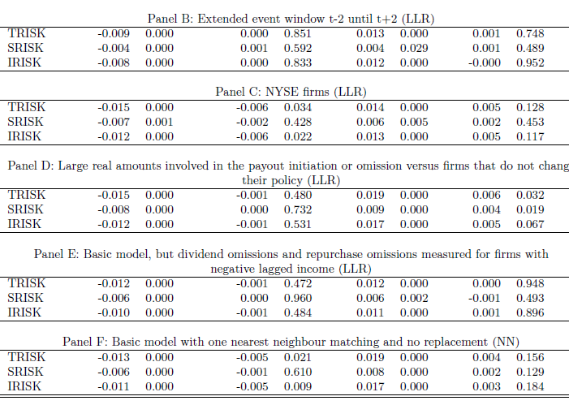
Table 2 Robustness checks

Slide 23
Table 3 Panel A

Slide 24
Our main findings
Set of hypotheses 1 (√):
We find declines in total, systematic, and idiosyncratic risk after dividend initiations (and increases after omissions)
Set of hypotheses 2 (≠):
There is no difference in absolute risk effects across dividend initiations and omissions
Set of hypotheses 3 (√):
Dividends exhibit risk effects but share repurchases do not

Slide 25
Conclusions
Like GMS (2002) we find effects on systematic risks after dividend initiations and omissions, but unlike G&M (2004) we do not find many systematic risk effects after repurchases.
We find even larger idiosyncratic risk effects. It may be thus be interesting to study whether the idiosyncratic risk effects also have larger value effects
Though the risk effects of omissions are slightly larger than from initiations, there is no significant difference: the larger value effects connected to omissions cannot be caused by linear risk change differences

Slide 26
THANK YOU
Comments and suggestions are still very welcome

Slide 27
The writing process (2 years only!)
I was approached by the special issue editor
We were working on a paper that fit the requirements
But it should be very good, so we started on something completely new: endogeneity of risk in payouts (in reaction to Chay and Suh, 2009)
Used US data; ultimately decided on PSM with DiD
Comments of four persons
About 14 pages of explications of how we coped
The most important and critical reviewer said “reject” to the third version, but liked the efficient market idea
This was already discovered by us in rewriting the third version, but we still did not show that clearly enough
I directly approached the editor, and we got a new chance

Slide 28
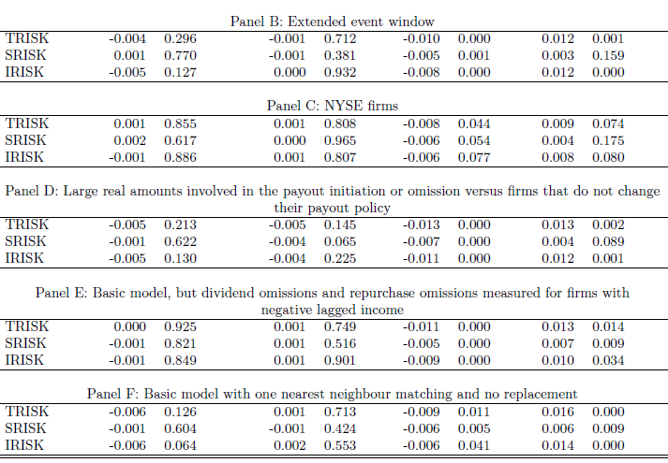
Table 3 Robustness checks

