Slide 1
Strategic Corporate Finance Recent insights in payout policies Henk von Eije University of Groningen

Slide 2
Great to be invited

Slide 3
Who am I?
http://www.rug.nl/staff/j.h.von.eije/

Slide 4
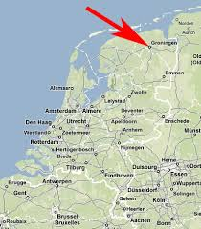
Where is Groningen?

Slide 5
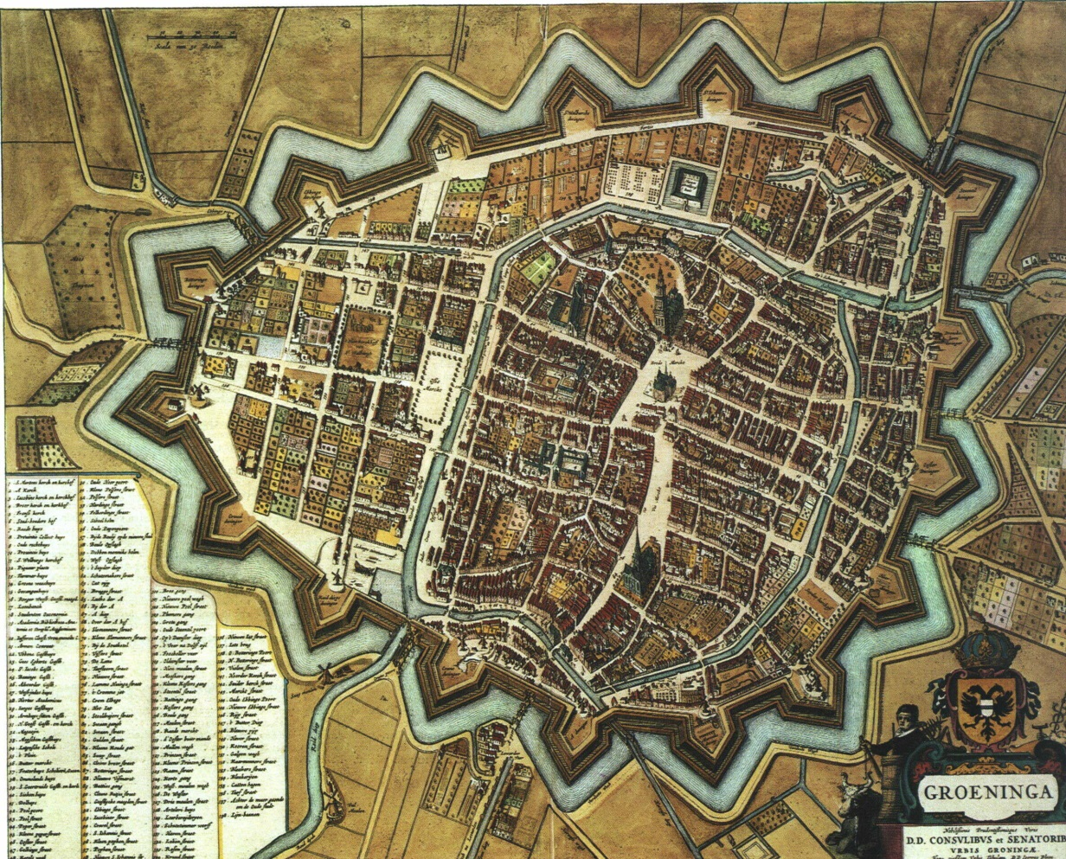
A small, but old city

Slide 6
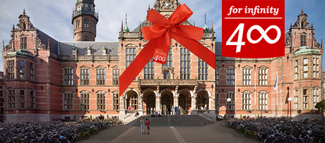
With a rather old university

Slide 7
A student city

Slide 8
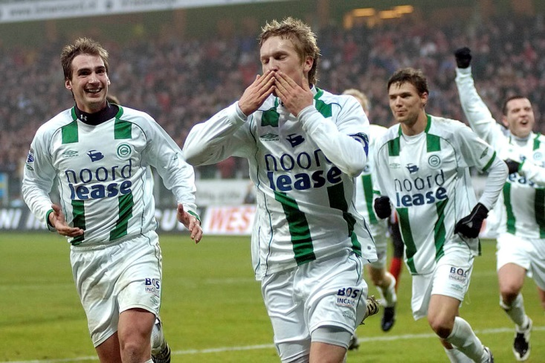
With a soccer/football club

Slide 9
Now the issue of payouts

Slide 10
Background: 2 papers
Henk von Eije and William L. Megginson (2008), Dividends and share repurchases in the European Union, Journal of Financial Economics, 89, 347-374.
Henk von Eije, Abhinav Goyal, Cal Muckley, Does the information content of payout initiations and omissions influence firm risks?, Journal of Econometrics, forthcoming

Slide 11
Many payout questions
What are payouts?
How do we measure them?
Do managers like them?
What are the long term trends?
What causes firms to pay or not to pay
If firms pay, what causes them to pay more?
Do shareholders like payouts?
Do debtholders like payouts?

Slide 12
What can you tell me on payouts?

Slide 13
Payouts
What are payouts?
cash dividends and
repurchases (buy backs)
How do we measure them?
by amounts paid and
whether firms pay or not

Slide 14
When do they occur? (institutional aspects)
Dividends are announced (announcement day), if restrictions set by banks and bondholders are avoided
Record day owners get dividends, then the stock is ex dividend (ex dividend day)
Generally the price of the stock declines but with a smaller amount per share than what is paid per share (tax reasons?)
Repurchases are announced, and generally during a (long period of time) shares are bought back

Slide 15
Payout issues
Lintner (1956)
M&M (1961) and market imperfections
Payout puzzles (tax imperfection)
Declining propensity to pay
Agency theory and other imperfections
Signaling (maturity and risk reduction)

Slide 16
Do managers like dividends?
Lintner (1956) interviewed managers and developed a theory, which is still very relevant
Firms increase dividends if their earnings increase
BUT, firms do not increase dividends directly
Managers are risk averse and adapt dividends slowly to earnings, because they are very afraid to reduce dividends if earnings become less

Slide 17
Lintner
Lintner’s theory can be measured by:
Dt = a0 + a1Et + (1 - a2)Dt-1
Where a₁ represents the sensitivity of dividends to current earnings and a₂ the speed of adjustment to current earnings

Slide 18
a₁ and a₂ in the EU

Slide 19
Dividends and repurchases

Slide 20
Lintner conclusion for EU
Managers are inclined (or forced) to payout more dividends (10.9% before 2000, 21.2% thereafter) …
Similar for total payouts (16.5% and 33.9%)
AND they also react faster to earnings

Slide 21
Then came modern finance theory
Modigliani and Miller (1958) capital structure
Miller and Modigliani (1961) dividend policy (paying now or later, or by dividends or repurchases) is irrelevant
IFF the capital markets are perfect and investors rational, then it is impossible to create value systematically through payout policies

Slide 22
What was the imperfection that Lintner (1956) found?

Slide 23
Lintner after M&M 1961
Lintner found that managers may not be indifferent, though according to M&M investers/owners/stockholders would be indifferent in perfect markets
Moreover, managers are risk averse, and invester/owners allow them to be so with respect to dividends

Slide 24
And it also implies …
That shareholders conclude on managerial behavior
Initiating dividends may be a signal of an increase of higher future earnings (or of more stable future earnings)
It may also indicate that managers do not want to use the cash for themselves
Stopping (omitting) dividends is very bad

Slide 25
Dividends
With dividends the shareholders are indifferent to paying dividends if the dividend per share (after tax) is equal to the reduction in asset value per share caused by the cash dividend payment
However, dividends are taxed by personal income tax, and then shareholders lose some value to the government
With a tax imperfection: do not pay dividends!

Slide 26
Repurchases
With repurchases the firm uses the cash to buy shares. Shareholders who sell the shares get the cash. Shareholders who do not sell get access to the remaining cash flows and assets
A fair repurchase price equals the value of the remaining assets per remaining shareholder
But, because repurchases are also taxed, firms should not repurchase either!

Slide 27
Funky dividends
http://www.youtube.com/watch?v=MUsaSCRdtYI

Slide 28
Payout puzzle
Despite taxation of dividends and repurchases, firms still pay out!
Is this caused by stupidly managed firms?

Slide 29
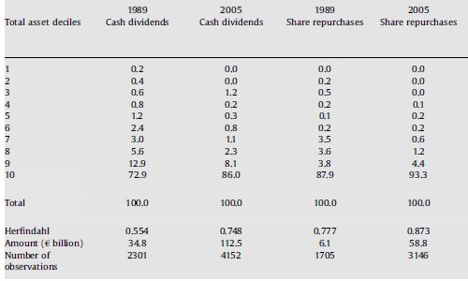
Payouts by asset decile EU

Slide 30
Dominance of large firms
Mostly payouts are done by large firms.
Are their managers less knowledgeable than managers of small firms?
This is not very likely; in fact small and large firms are generally rationally managed, though not necessarily on behalf of the shareholders
So there may be other reasons than stupidity!

Slide 31
Tax rates differ too
Dividends are often taxed at a higher rate than repurchases
So what should be paid more?
Dividends or repurchases?

Slide 32
Trend in total payout amounts (EU)

Slide 33
Dividend and repurchase amounts
If dividends are taxed more, dividend amounts should be lower than repurchase amounts
In fact the opposite is true, so tax may not be the major driver
But … repurchase amounts increase faster and Skinner (2008) finds that repurchases are dominant now in the US
Still, tax is -at best- a relative explanation

Slide 34
Non-tax explanations
Irrational behavior?
Asymmetric information?
Signals on future earnings
Signal on lower growth opportunities
Agency problems?
Size, leverage, retained earnings, age
Firm risk?
Country / industry / firm background?

Slide 35
Irrational behavioral theories
Clientele effects
Shares owned by widows, orphans, elderly and/or financial institutions (Mutual funds)
Cyclical managerial behavior
Only paying if dividend payers have a higher price to book value than non-payers (Baker and Wurgler, 2004)
Dove in the hand theory
http://slack-time.com/music-video-4944-wiley-money-in-my-pocket-cash-in-my-hand

Slide 36
Amounts versus payers
Dividend and repurchase amounts have been increasing
But what happened to dividend and repurchase payers?

Slide 37
Trend in cash dividend payers

Slide 38
What may have caused this?
1) …
2) …
3) …

Slide 39
What may have caused this?
New firms get listed and have less spare money (1)
Existing firms may also have different characteristics nowadays (2)
There may be a declining propensity to pay according to Fama and French (2001) (3)

Slide 40
Fama and French, 2001
The propensity to pay cash dividends has declined in the USA
Young listed firms are generally smaller, have less earnings and need more cash for investments and growth
So control for these firm characteristics (What measures would you use?)

Slide 41
Four variables of F&F 2001
Firm size (+), Earnings (+), Past investments (-), Expected growth (-)
Measure the sensitivity of paying (or not paying) for these variables in an early period
Keep the resulting parameter estimates constant for next years and use these to estimate the number of expected payers
Compare these to the actual number of payers

Slide 42
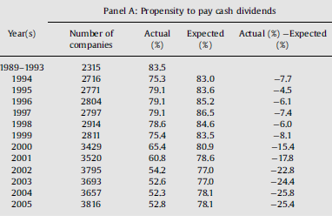
Dividends disappear also in the EU

Slide 43
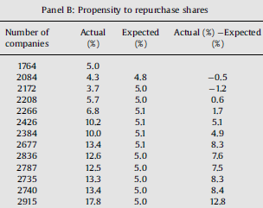
But repurchasing firms appear

Slide 44
Remember the explanations
Earnings
Asymmetric information?
Growth opportunities, investments
Agency problems?
Size, leverage, retained earnings, age
Firm risk?
Country, industry and firm background?
Irrational behavior?
Tax

Slide 45
What drives firms to pay?

Slide 46
Conclusions on payers
Agency costs
Size (Lsize), Leverage (LLR) and AGE influence cash dividends significantly in the expected direction
Earnings (LEA), investments (LDDA) and growth opportunities (LMBF), and industry (T) also do so
Moreover firm risk (LSDS), Tax (DTP), and being in a common law country does so too

Slide 47
What drives payment amounts?

Slide 48
Similar conclusions on payment amounts
Again agency costs and growth opportunities
Size (Lsize), Leverage (LLR), AGE and retained earnings (character of firm age)
Earnings (LEA), investments (LDDA) and growth opportunities (LMBF), and time (T) also do so
New correct significant variables are cash holdings (LCASHA) and being a privatized firm (PRIV)

Slide 49
Second paper
In 2002 Grullon et al. indicate that the value may increase –not as much as a signal of future earnings- but as a signal on firm maturity and a concomitant reduction (increase) in risk
We check whether this is the case after major payout event initiations (omissions) in an econometric precise way

Slide 50
Risk effects (US)

Slide 51
No systematic differences between initiators and omitters

Slide 52
Conclusion
We find the expected risk effects for dividends but not significantly so for repurchases
Interestingly, it is not only systematic risk, but also idiosyncratic risks
Unanswered: Do the positive (negative) value effects after initiations (omissions) arise from risk effects and does idiosyncratic risk also matter?

Slide 53
What to remember?
Payouts consist of dividends and repurchases and is measured by amounts and incidence (paying firms)
Lintner (1956) developed a very important theory based on managerial risk aversion
After Miller and Modigliani (1961) many theories are developed that (partially) work in the EU, like tax, irrational behavior, agency theory, and maturity signaling
There is a major reduction in firm risks after initiations and an increase after omissions

Slide 54
Спасибо

